Slide 1

Capstone 2: Applied Machine Learning For Daily Fantasy Hockey
Michael Wood
Springboard Data Science Capstone 2
September 2019

Slide 2
Why Daily Fantasy Hockey?
The objective of this capstone project was to create and deploy machine learning models that would be able to successfully predict player performance in daily fantasy hockey, an online contest where the objective is to choose the highest scoring lineup in a series of NHL contests. This is a constrained optimization problem in that contest entrants are provided a ‘budget’ of $50,000 to spend on 8 NHL players, who’s salary for a contest could range from $2,500 to $9,000.
This is no easy task since hockey as a sport is widely considered the most difficult to predict due to the level of interaction among players, difficulty isolating events, and general ‘puck luck’. ¹ The value proposition is that by most conservative estimates daily fantasy sports is a multi-billion dollar industry, and even the smaller contests offer value with daily NHL contests paying out up to $5,000 for a first prize for a $3 entry.²

Slide 3

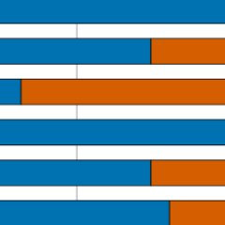
Data Collection
The data scraped from the NHL’s unofficial API, and then processed using scripts developed by the team at EvolvingHockey¹, an invaluable resource for daily results.

Slide 4
Key Terms for Features
A few essential hockey terms that will be used going forward:
Power Play: period where at least one opposing player is serving a penalty and the team has the advantage of an additional skater.
Short Handed: the inverse of the above, the situation of playing with one or more fewer player(s).
Time-On-Ice (TOI): the amount of time a player is involved in actual play. Also represented as percentage of a teams TOI, power play TOI, and short handed TOI.
Fenwick/Corsi: measurements of a players number of unblocked shots or total shots, respectively.
Points: can refer to either fantasy points or points as recorded by the NHL. In the later case points are either a goal or assist to a goal.

Slide 5
Preprocessing And Primary Feature Gathering
For this project, most of the data was in a raw format from the API and required compiling on a player-per-game instance. That was assisted by the Evolving Hockey scripts, but also required a PostgreSQL instance be stood up to house the data and easily access it, as well as create rank ordering functions.
Additionally, significant work was done to break the API scraping down into chunks to reduce the load on the local machine.
Given the nature of the data (a published API of official records) there were no NaN or missing values. Instead there were some errors caused by the multilevel scripting of the API which caused some redundant records. Once identified as being redundant by counting the total rows vs unique name::game_id combinations it was relatively easy to strip them out.

Slide 6
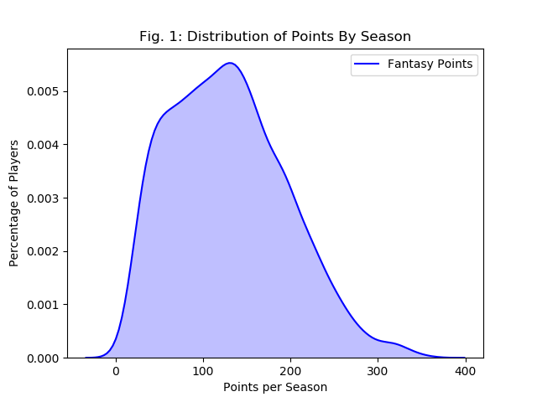
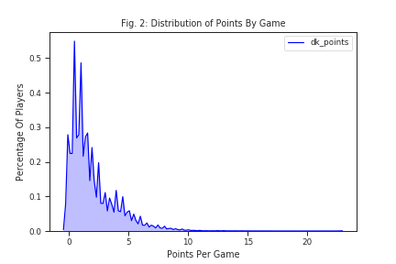
Data Exploration
While fantasy points, the primary target metric, are generated by the same actions such as goals and assists in both daily and season long contests they do not have the same distribution. On a per-season basis the points are normally distributed (fig. 1) while on a per-game basis the distribution is very strongly skewed to the right (fig. 2). This is important as gradient descent models that were deployed both in the previous capstone and tested here are sensitive to the scale.

Slide 7
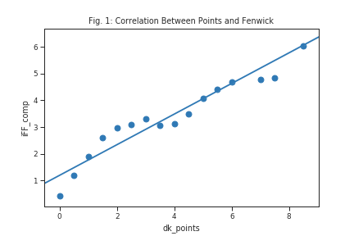
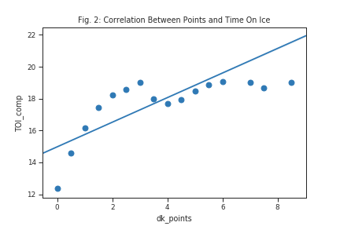
Data Exploration
Fenwick (fig. 1) remains a constant for forecasting points, does TOI (fig. 2). ¹

Slide 8
Applied Market Forecasting Theories: Moving Average Convergence Divergence
The ‘hot hand theory’¹ states that if a player recently did well in the most recent last event, they would perform well in the next. For example if a hockey player scored a goal with a shot, then their next shot would be more likely to also be a goal. In this case the concept was to improve upon this by using an idea from financial analysis, Moving Average Convergence Divergence (MACD).
MACD originated an indicator to reveal changes in direction or momentum in a stock price. Here the intent is for the MACD to act as an indicator of changes in direction in the important values Time on Ice or Fenwick. These features correlate strongly with overall performance, therefore an improvement in them would identify players who are undervalued as well as predict positive movement in future games.

Slide 9
Applied Market Forecasting Theories: Moving Average Convergence Divergence
MACD is created by subtracting the larger of two averages of the same number to create a signal. Shown in the formula here, x bar is the sample mean of the feature over the number of games chosen.
For example, with Time on Ice (TOI) we utilized the respective periods of the 5 and 20 previous games. If the player averaged 12 minutes of TOI over the previous five games and 10 over the previous 20, this would make the player’s MACD +2.
If the MACD is a positive value that would be considered a ‘buy’ signal, if negative it would be a ’sell’ signal.

Slide 10
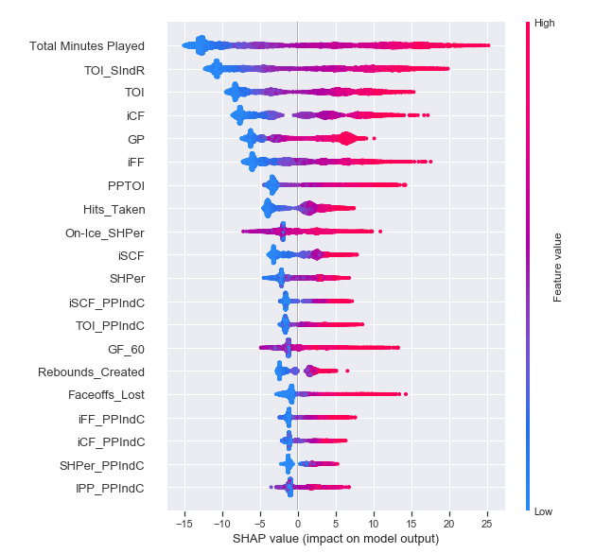
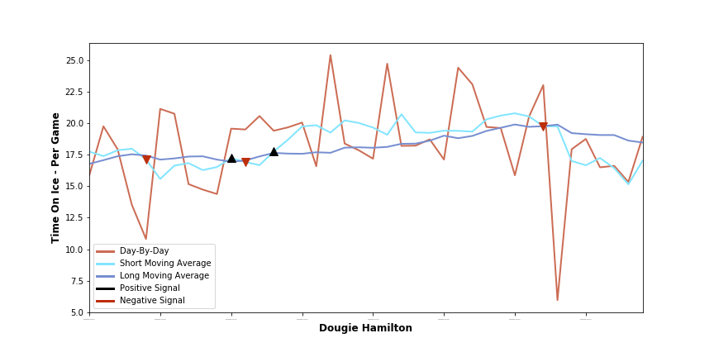
Applied Market Forecasting Theories: Moving Average Convergence
The next few slides are a random sample of players with the positive signal marked by a black arrow and negative signal marked by a red one. The markers are overlaid on top of the moving averages (blue and dark blue lines). Note Dougie Hamilton on the left: the black arrow frequently proceeds a distinct upward trend in the moving averages, while the red correctly shows a negative trend.

Slide 11
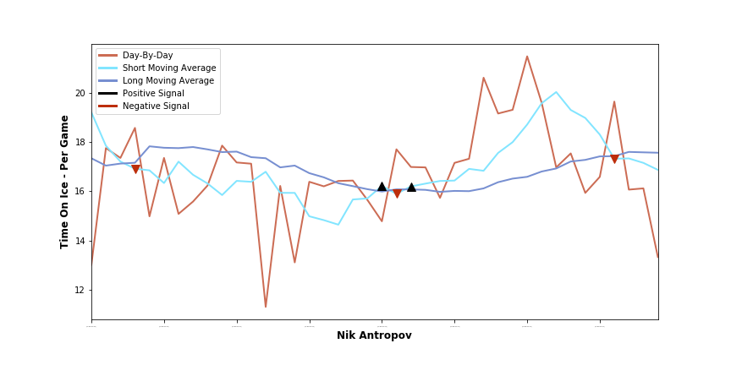
Applied Market Forecasting Theories: Moving Average Convergence
This is another fairly stable player, Nik Antropov; notice how the two positive signals, as marked by the black upwards arrow in the middle of the chart, directly preceded a long term positive trend.

Slide 12
Applied Market Forecasting Theories: Moving Average Convergence
This is another fairly stable player, Nik Antropov; notice how the two positive signals, as marked by the black upwards arrow in the middle of the chart, directly proceeded a long term positive trend.

Slide 13
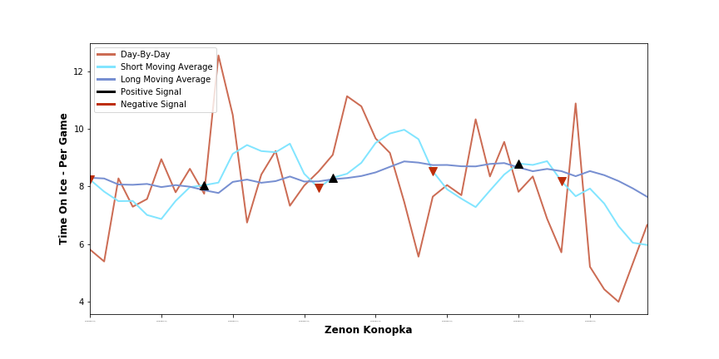
Applied Market Forecasting Theories: Moving Average Convergence
That said, the model can be ‘psyched’ out, as seen here with Zenon Konopka, by highly uneven deployment which could be caused by a number of factors. As seen on the left there are short term positive trends after the positive signal, but they are not maintained long term.

Slide 14
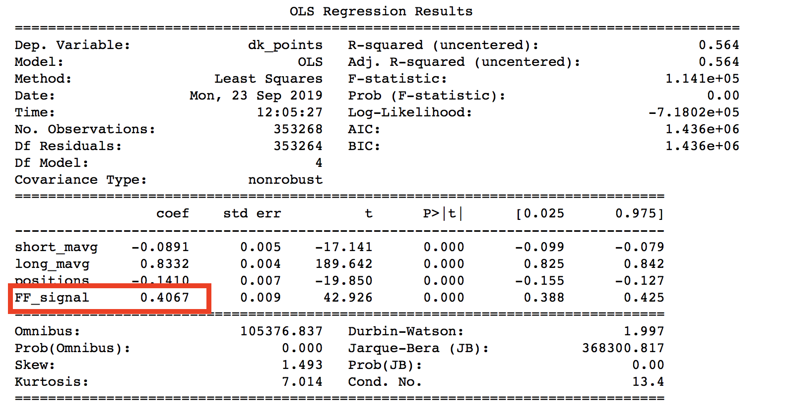
Applied Market Forecasting Theories: Analysis of Moving Average Convergence
In order to gauge the effectiveness of this signal a regression analysis was performed to measure the relationship between the signals and the target, dk_points, they were intended to predict. This analysis showed that if a player had a positive Fenwick signal the mean value increased by 0.4 points. Considering that the mean performance is 2 points, this is meant a positive signal forecast an average increase of 20% in overall performance.

Slide 15
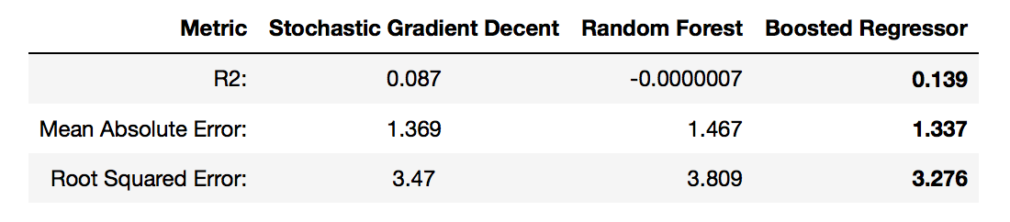
Model Building: Initial Failure
The primary models employed were Stochastic Gradient Descent, Random Forests, and Gradient Boosted Regressors. They were selected for their speed, accuracy, ability to deal with overfitting, and their predictive power. Additionally the data was transformed by a scikit-learn StandardScalar. The scaling was an important step to normalize the distribution of the data as the selected machine learning models perform worse when the data is not normally distributed.
The first iteration failed in spectacular fashion. Shown here are their error rates:
R2 shows the predictive power of a model on a 0-1.00 scale, while the other values show the average error rates. Keep in mind, that the average points per game is 2 points, so missing by 1.4-1.3 points is being off by almost a complete game’s worth of points.

Slide 16
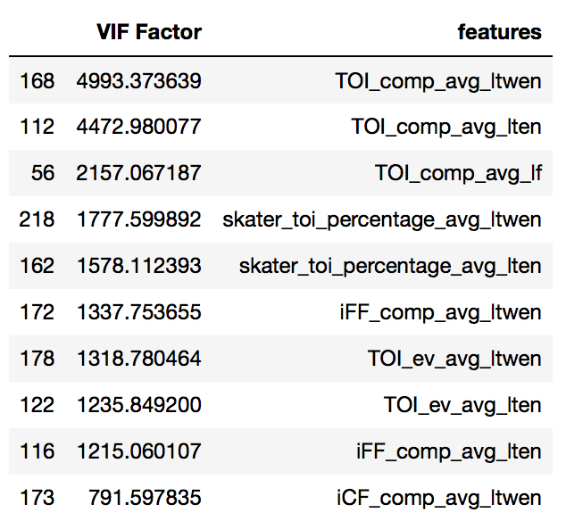
Model Building: Initial Failure
Upon inspection it appeared the problems were two-fold: first, a Variance Inflation Factor (VIF) analysis confirmed that the features were highly correlated amongst themselves and thus multicollinear. This meant that key features were repeating themselves and creating signal where there was none. This chart shows the most correlated values. A VIF score of below 5-10 is considered acceptable; of the 228 features we charted here, 7% were under 5, and 15% were below 10.

Slide 17
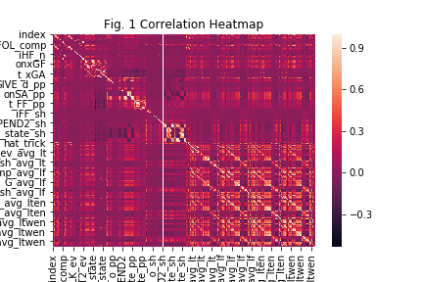
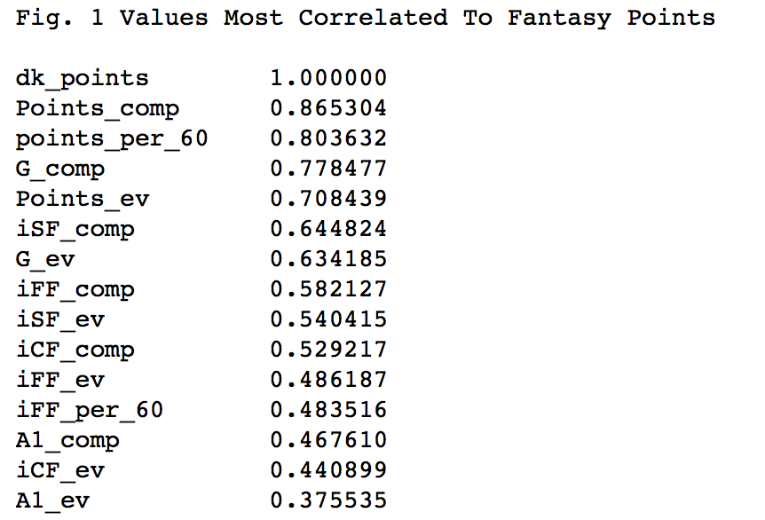
Model Building: Initial Failure
Presented another way, this is a correlation matrix (fig. 1) showing the correlation of values amongst each other. Lighter values represent higher correlation: note how light the chart becomes in the later levels. Next (fig. 2) are the levels most correlated with points themselves. SF and FF are ’Shots For’ and “Fenwick For’ respectively.

Slide 18
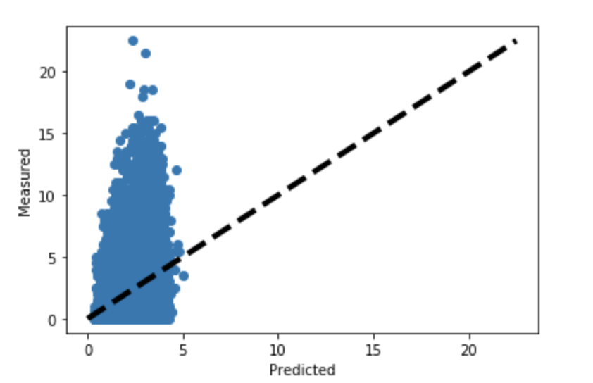
Model Building: Initial Failure
The models also had a hard time creating realistic projections. The chart on the left is of one of the Gradient Boosted models, with the actual outcomes on the y axis and predicted on the x axis. Note that the measured values frequently reach above 10 or 15 points while the predicted values are locked between 0-5 points.

Slide 19
Model Building: Moderate Success
Given this challenge in predicting values a Poisson Regression Model was attempted as an alternative. Poisson Regressions work better as they are designed to fit a discrete probability distribution of the rate of events. Wikipedia explains these as the “probability of a given number of events occurring in a fixed interval of time … examples that may follow a Poisson distribution include the number of phone calls received by a call center per hour^{”1.}

Slide 20
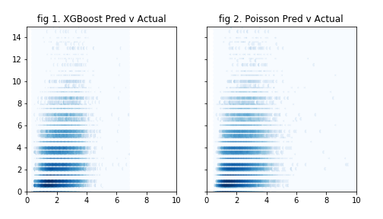
Model Building: Moderate Success
The primary reason the Poisson model was an improvement was the projected values were more in line with expectations. The mean value was still about 2 points, but the standard deviation was 0.75 instead of 0.6. Note the plotting here as opposed to the boosted regressor shown before.

Slide 21
Application: Goals and Tools
Given the capstone’s primary objective of being able to supply accurate projections for daily fantasy contests, having a predictive model was not enough. The model should be able to predict actual performance in daily contests, which presented its own challenges: 1) companies do not regularly publish contest results, and 2) the NHL hockey season had not begun so live testing was not possible.
To circumvent that a test was devised using FantasyCruncher, a tool which is considered an essential lineup optimizer by most daily fantasy sports professionals. FantasyCruncher assists in three ways: 1) it has a historical database of players, “LineupRewind”, that lets you see previous player performance alongside their own models, 2) the site allows players to upload their own models, and 3) can create multiple lineups on any given day using either FantasyCruncher or player models.
For the back test five days were chosen at random, three of which had data in FantasyCruncher, 2/23/2016, 5/11/2016, and 10/27/2018. The model was imported for those dates, and lineups were created using both the model and the generic projections provided by FantasyCruncher. A lineup can be considered successful if it exceeded 35 points in one of these simulations, which is the typical minimum value needed to cash and earn a player money.

Slide 22
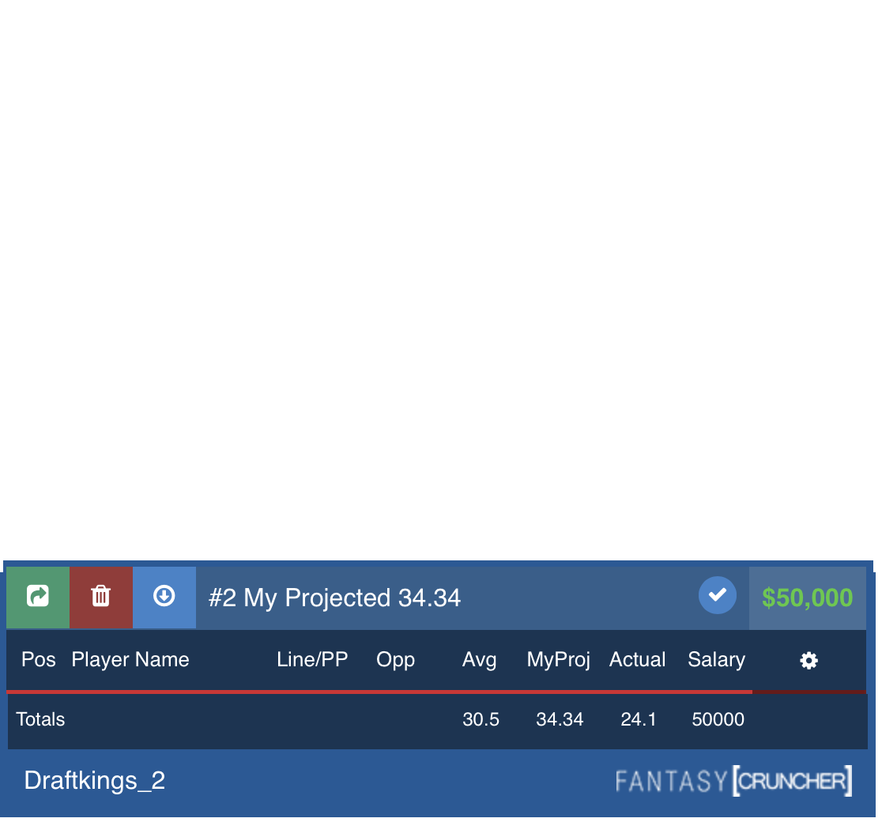
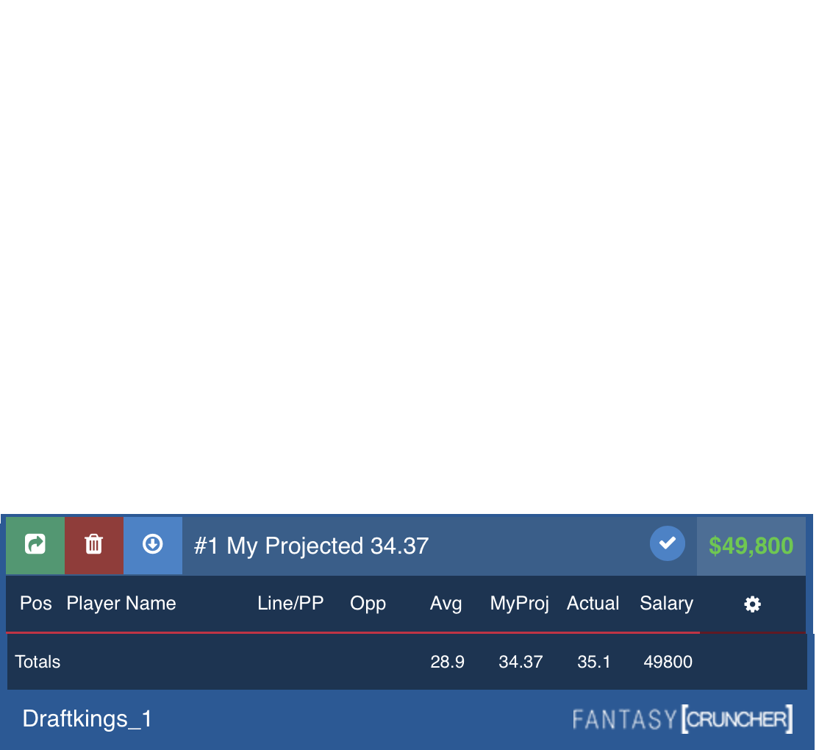
Naïve Application
In naïve contests, those without human input, the model did not out-perform the off-the-shelf projections, and in fact were rarely selected by the platform. Below is a comparison of the naïve lineups (upper) and FantasyCruncher (lower).
Again, the typical lower bound for cashing in in a contest is 35 points so given that target the FantasyCruncher lineup would have succeeded while the naïve model would not.

Slide 23
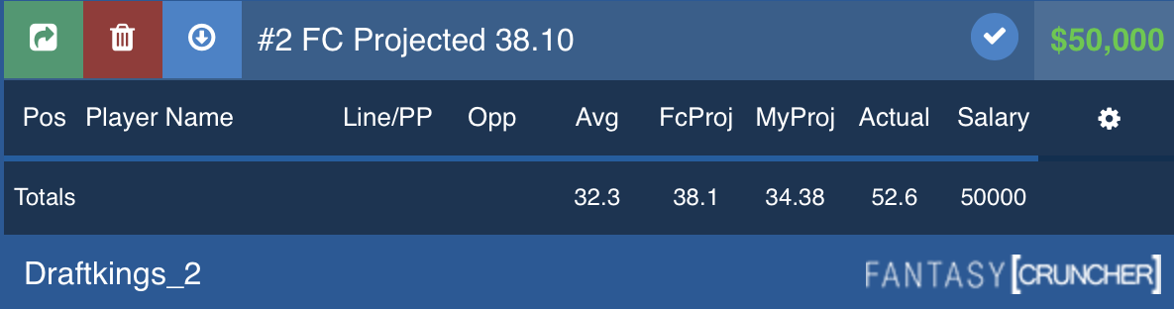
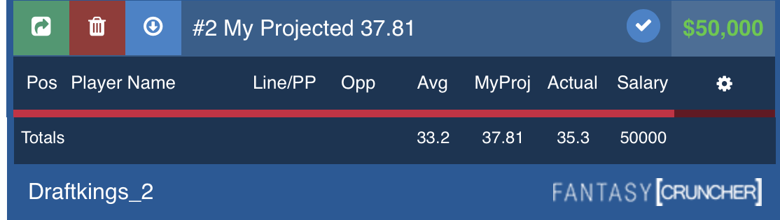
Non-Naïve Application
That said, the story is wildly different given even minimal human supervision. In these examples, FantasyCruncher was limited to two options in the goalie position, selected solely based on being the starting goalie for the team most favored to win by the Las Vegas Casinos. I set the same assignment for the FantasyCruncher model but the scores were wildly different in this case. The Non-Naïve model (left) would have done significantly better than FantasyCruncher alone (right).

Slide 24
Extensions
Given additional time to do further iterations of this capstone, there are a number of additional angles that could be pursued to add further value or otherwise explore for new features. Four stand out as primarily being viable:
Further apply Las Vegas odds: use the Vegas lines as direct inputs to create features such as percentage likelihood of a team generating more goals and therefore points.
Consider strength of opponent metrics; marry the trends of the opposing teams to the basic stats. For example, similar to how a player might have recently seen a positive MACD signal, playing against a team with a strong defensive signal could counter that and forecast a decrease in goals scored.
Attempt another Poisson model with more stripped out features. Models were attempted based on position but perhaps a KNN to differentiate valuable players and only project their performance would be lower variance with more upside.
Find ways to increase the points spread in the target variable: a more naturally occurring normal distribution might also increase accuracy in predictions.

Slide 25
Conclusions
While the model isn’t predictive enough to be a stand alone product, minimal human coaching can make it viable.
Significant challenges remain in finding more predictive features that aren’t multicollinear or otherwise reproductions of basic stats. Appropriate model selection for the type of distribution are important as well.
The moving averages have some promise, and perhaps an even simpler model based on those and core features might perform just as well.

Slide 26
Acknowledgements
There were many reviewers who added edits and helped greatly improve this presentation. Thanks to Marcia Burchby, Dayna Clark, Jimena Gargiulo, Megan Ogle and George Wood, among others.
But I’d primarily like to thank both my mentor for this course, Alex Rutherford, and my mentor throughout my data science career, Michael Burton, for helping along the way to guide my progress, point out areas of improvement, and generally being great sounding boards. This project would be much less successful without them.

